Slide 1
2-Level Voltage Source Traction Inverter
Enes Ayaz

Slide 2
Agenda
  Power Ratings of 2-Level Inverter
  Power Modules (Infineon 2kV) Parameters
  Inverter Loss Estimation with Datasheet Values
    Updating Loss for Different Switching Speed
  Harmonic Losses on the Motor
    Impedance Modelling
    Voltage-Current Measurements
    Proposed Improved Impedance Modelling
  Die area and Switching Frequency Selection (Total Losses)
  Capacitance Requirement
  Coming Works

Slide 3


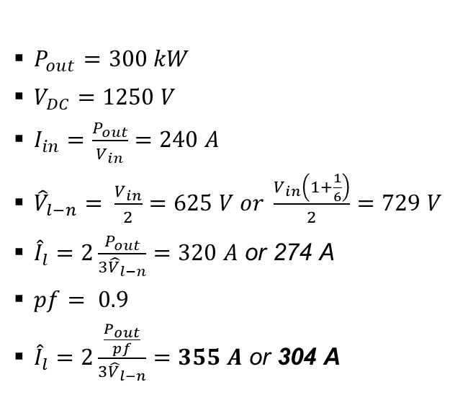
2-Level Inverter Power Ratings
$P_{out}=300 kW$
$V_{DC}=1250 V$
$I_{in}=\frac{P_{out}}{V_{in}}=240 A$
${\hat{V}}_{l−n}= \frac{V_{in}}{2}=625 V or \frac{V_{in}\left(1+\frac{1}{6}\right)}{2}=729 V$
${\hat{I}}_{l}=2\frac{P_{out}}{{3\hat{V}}_{l−n}}=320 A$ or 274 A
$pf= 0.9$
${\hat{I}}_{l}=2\frac{\frac{P_{out}}{pf}}{{3\hat{V}}_{l−n}}=355 A$ or 304 A
Efficiency (99.5%)
Semiconductor Losses (6 switches): 1500 $W$
A phase leg of a conventional two-level inverter
consists of two transistors that block and switch
the full dc-link voltage.
Two-level inverters are less complex than the
other topologies and have the least control effort.
On the other hand, the connected machine suffers from higher harmonic losses and the steep voltage slopes can damage it by causing bearing currents or overstressing the winding insulation.
Two-level inverters have a bad efficiency for higher switching frequency.

Slide 4
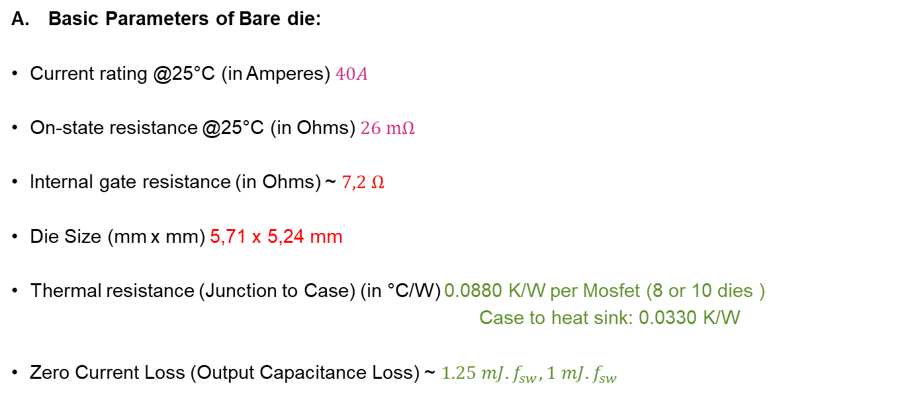
Parameters of Infineon 2kV Bare die
Basic Parameters of Bare die:
Current rating @25°C (in Amperes) $40A$
On-state resistance @25°C (in Ohms) $26 mΩ$
Internal gate resistance (in Ohms) ~ $7,2 Ω$
Die Size (mm x mm) 5,71 x 5,24 mm
Thermal resistance (Junction to Case) (in °C/W) 0.0880 K/W per Mosfet (8 or 10 dies )
Case to heat sink: 0.0330 K/W
Zero Current Loss (Output Capacitance Loss) ~ $1.25 mJ. f_{sw}, 1 mJ. f_{sw}$
Considering this current rating of a single die, it seems we have around 8-16 dies in parallel.

Slide 5

Datasheet-Driven Loss Estimation
Voltage rating: 2kV
Current rating: 400A
FF3MR20KM1H using 8 or 10 dies in parallel
58 mJ at 304 A
17 mJ at 304 A
$$\frac{26}{10}=2.6mΩ$$

Slide 6
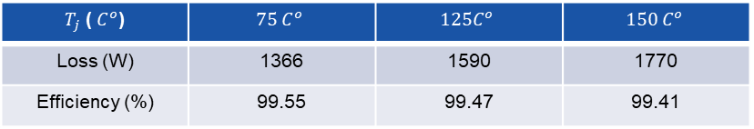
Datasheet-driven Loss Calculation
Switching frequency = 5kHz, ma=1.15, pf=0.9 2-level 3-phase, P=300kW
The maximum switching frequency is 5kHz since we have slow switching speed (dv/dt) test data in the datasheet.
The current is sinusoidal.
$T_{j}$ ( $C^{o}$) | $$75 C^{o}$$ | $$125C^{o}$$ | $$150 C^{o}$$
Loss (W) | 1366 | 1590 | 1770
Efficiency (%) | 99.55 | 99.47 | 99.41
Assume only conduction loss is changed with temperature.
We do not use a thermal model here; we just find the losses for different junction temperatures.

Slide 7
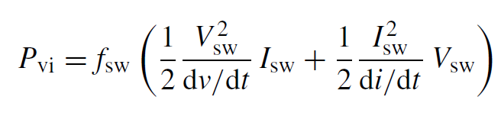

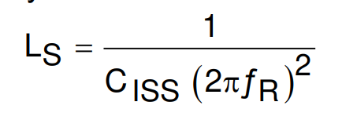
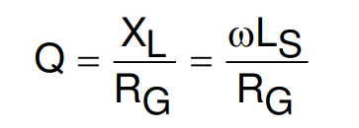
Updating Switching Losses for Fast dv/dt
58 mJ at 304 A
17 mJ at 304 A
10mJ
Overlapping loss
Output capacitance loss
Depends on dv/dt and di/dt
Linearly increasing by the number of dies in parallel

Slide 8
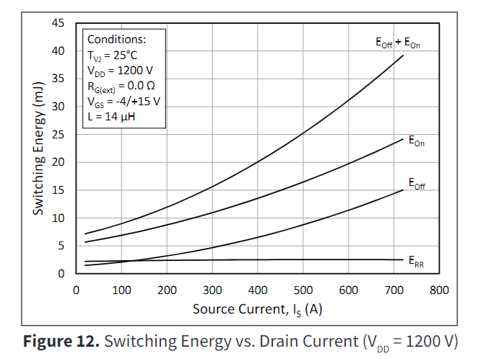
Updating Switching Loss for Fast dv/dt
Scaled by considering 1.7 kV Wolf-Speed power modules which have test data with higher dv/dt

Slide 9
Updating Switching Losses for Fast dv/dt
Number of Dies area selected as minimized the losses regarding the switching frequency.
Junction temperature is taken at $75 C^{o}$.

Slide 10

Other Cases
If junction temperature is taken at $100 C^{o}$
If we lower dv/dt 2.5 times

Slide 11
Harmonic Losses on the Motor
We have trade-off between motor harmonic losses and inverter losses.
Optimum point
Decreasing trend
Increasing trend

Slide 12
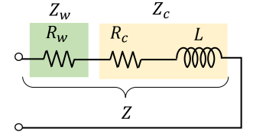
Harmonic Losses Estimation- Impedance Model

Slide 13
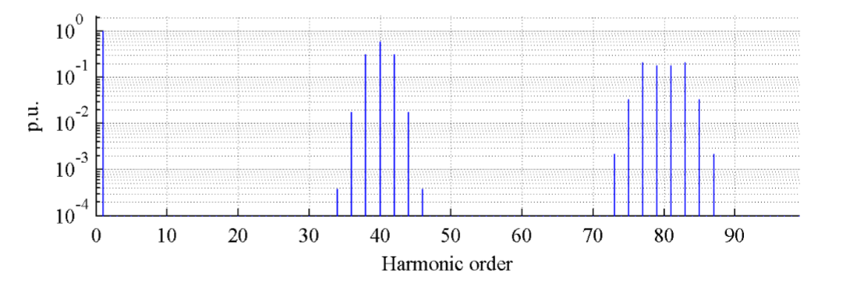
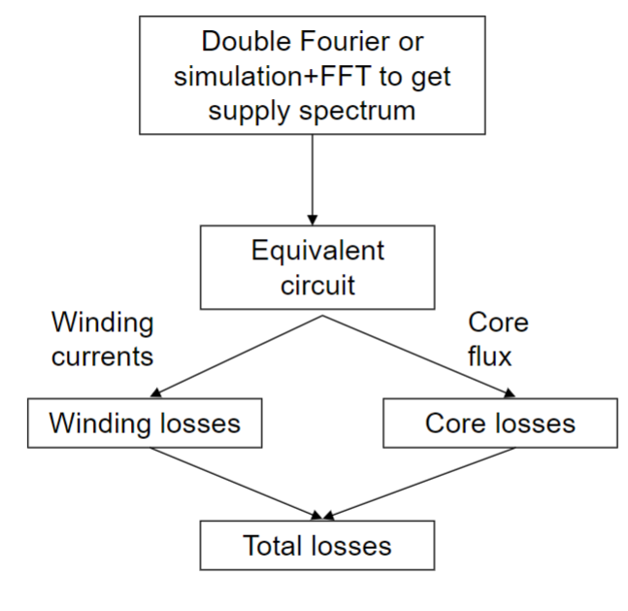
Harmonic Losses Estimation-Impedance Model
Harmonic distribution changes regarding inverter operation
Loss Factor

Slide 14


Harmonic Losses Estimation-Impedance Model
$$f_{sw}= 10 kHz$$
$$m= 1$$

Slide 15
Harmonic Losses Estimation - Measurement
300 Hz fundamental frequency
10 kHz switching frequency

Slide 16
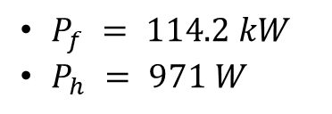
Harmonic Losses by measurements
$P_{f} = 114.2 kW$
$P_{h} = 971 W$
There is an interaction between these frequencies so that we observe some harmonics generating power.

Slide 17




Harmonic Losses Estimation - Measurement
$P_{h}=P_{h−stator}+P_{h−rotor}$
n= harmonic number
$$P_{n}=V_{n}^{2}. K_{h}(n)$$
$$P_{n}=V_{n}^{2}. K_{h}(n±1)$$
We can apply superposition here.
$K_{h}$ = harmonic loss factor
Rotor sees a frequency different from the excitation frequency, which depends on the sequence of the excited harmonic and fundamental frequency.
The fundamental component is stationary regarding the Rotor.

Slide 18




Harmonic Losses Estimation - Measurement
Rotor side
$$f_{sw}+3f_{o}$$
Negative sequence
$$f_{sw}+2f_{o}$$
P1
$$f_{sw}+4f_{o}$$
$$f_{sw}+3f_{o}$$
Positive sequence
P2
Same frequency
$P_{{(f}_{sw}+2f_{o})}=P_{{(f}_{sw}+2f_{o})−s}+P_{{(f}_{sw}+2f_{o})−r}$
$P_{{(f}_{sw}+4f_{o})}=P_{{(f}_{sw}+4f_{o})−s}−P_{{(f}_{sw}+4f_{o})−r}$

Slide 19

Harmonic Losses Estimation - Measurement
$P_{{(f}_{sw}+2f_{o})}=P_{{(f}_{sw}+2f_{o})−s}+P_{{(f}_{sw}+2f_{o})−r}$
$P_{{(f}_{sw}+4f_{o})}=P_{{(f}_{sw}+2f_{o})−s}−P_{{(f}_{sw}+2f_{o})−r}$
$P_{{(f}_{sw}+2f_{o}) }={1.8 K}_{s}+1.8 K_{r}=221/1600$
$P_{{(f}_{sw}+4f_{o})}={1 K}_{s}−1 K_{r}=−104/1600$
$${ K}_{s} =\text{0.0}\text{05}\text{9}$$
$K_{r}$= 0.0709
Rotor loss is dominant?

Slide 20
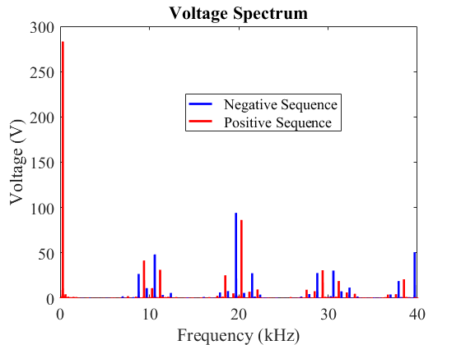
Harmonic Losses Estimation – Proposed Method
Voltage Spectrum
Positive Sequence
Negative Sequence
Stator Loss
Factor
Rotor Loss
Factor
Rotor Loss
Factor
Stator Loss
Factor
+
+/-
-/+
+

Slide 21
Total Losses Calculation
Optimum switching frequency

Slide 22
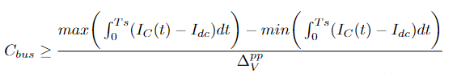



DC-link Capacitance Requirement-Switching Frequency
$$ΔV^{pp}=12.5 V$$
$$m=1.15$$
$$I_{c}=S_{A}I_{A}+S_{B}I_{B}+S_{C}I_{C}−I_{dc}$$

Slide 23
Coming Works
Designing and building a 2L inverter as a reference design
Modeling harmonic losses by experimental loss factor calculation
Comparison of 3L topologies (3L-NPC and 3L-T-TYPE) with 2L reference design

Slide 24
Missing Information or Questions?
Component selection for 2L inverter
  Current / Voltage measurement sensors
  Gate driver specifications (additional measurements ?)
  Heatsink

Slide 25
Thanks !!!

